Slide 1

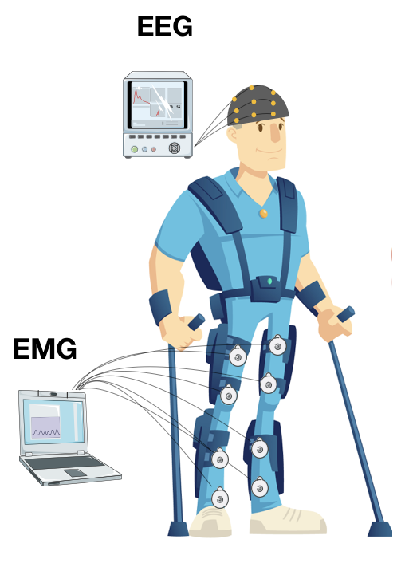

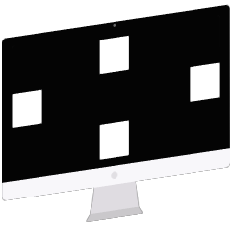
Brain Computer Interfaces

Slide 2
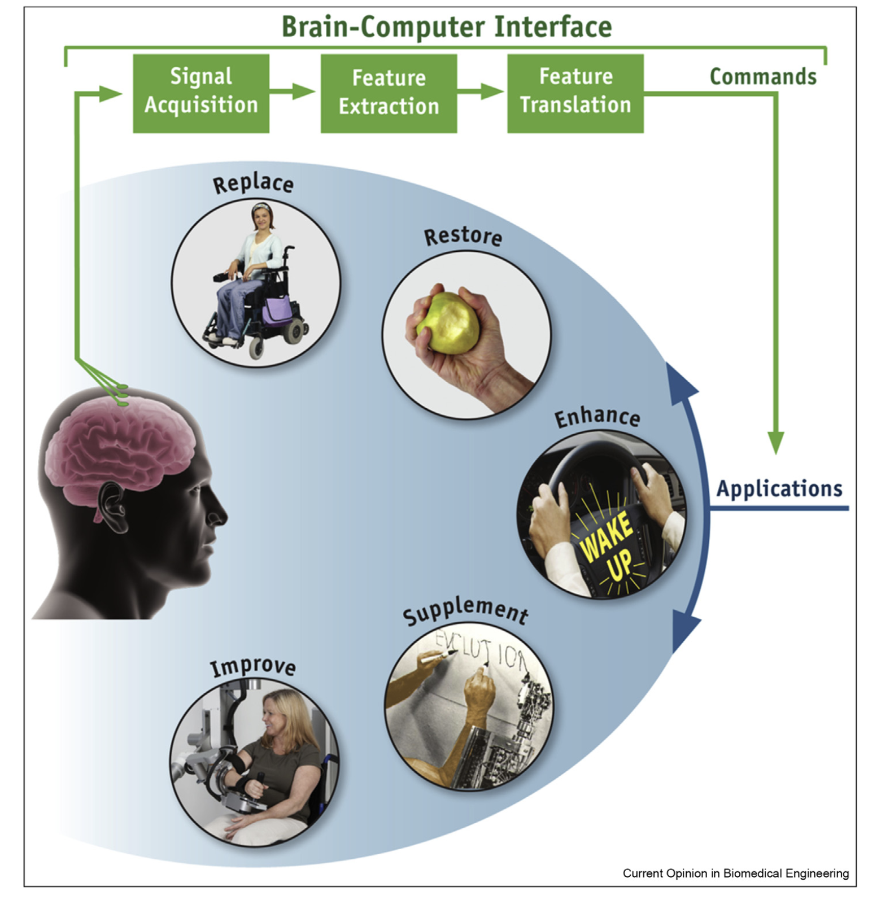
Electroencephalography (EEG)-based brain-computer interface (BCI)
EEG is the non-invasive technique
The continuous recording of electrical brain activity
Electrical signals produced by brain activity are recorded from the scalp, from the cortical surface, or from within the brain
They are analyzed to measure specific features (e.g., amplitudes of EEG rhythms or firing rates of single neurons) that reflect the BCI user’s intent
These features are translated into commands that operate applications

Slide 3
Motor imagery (MI) Based BCI
Brain-Computer Interfaces (BCIs)
Brain signal acquisition
Pre-processing
Feature extraction
Classification model
“Motor imagery (MI) is defined as the cognitive process of imagining the movement of your body part without actually moving that body part”
Feedbacks: Visual, Haptics, Auditory, etc.

Slide 4
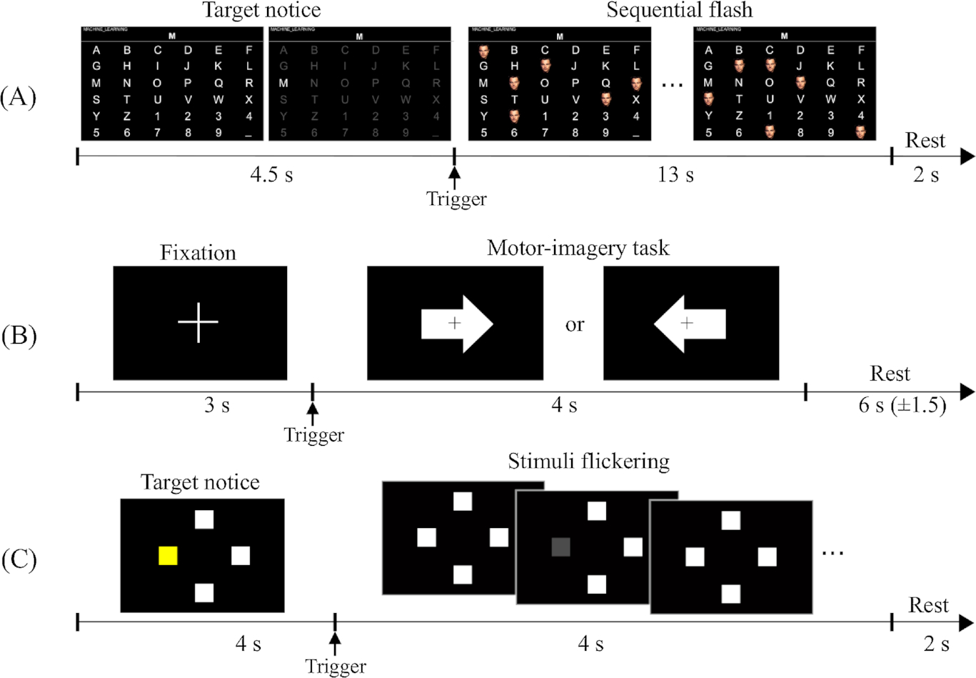
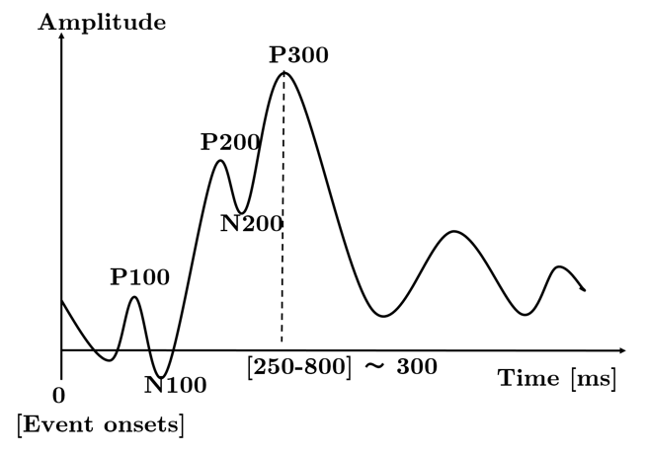
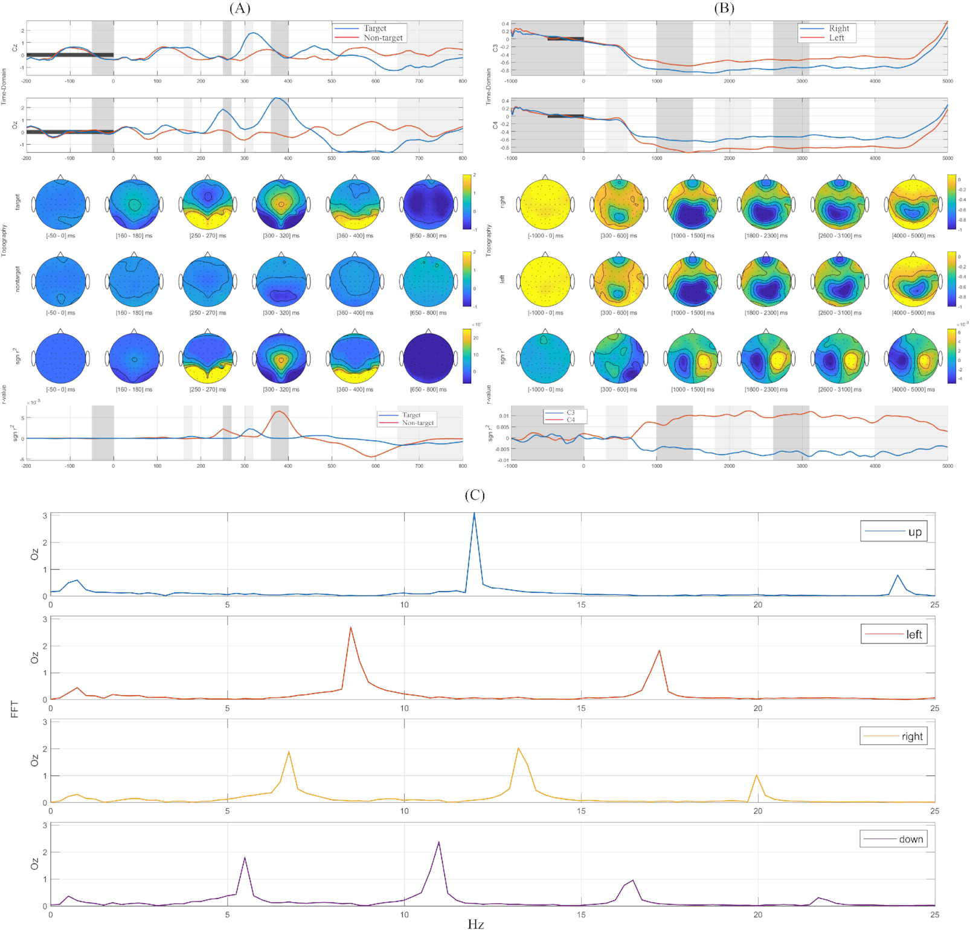
Event-Related Potential (ERP) Based BCI
The 6×6 ERP speller layout

Slide 5
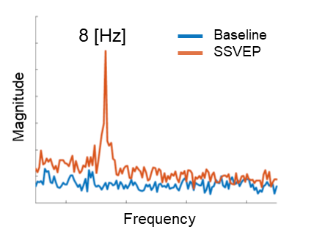
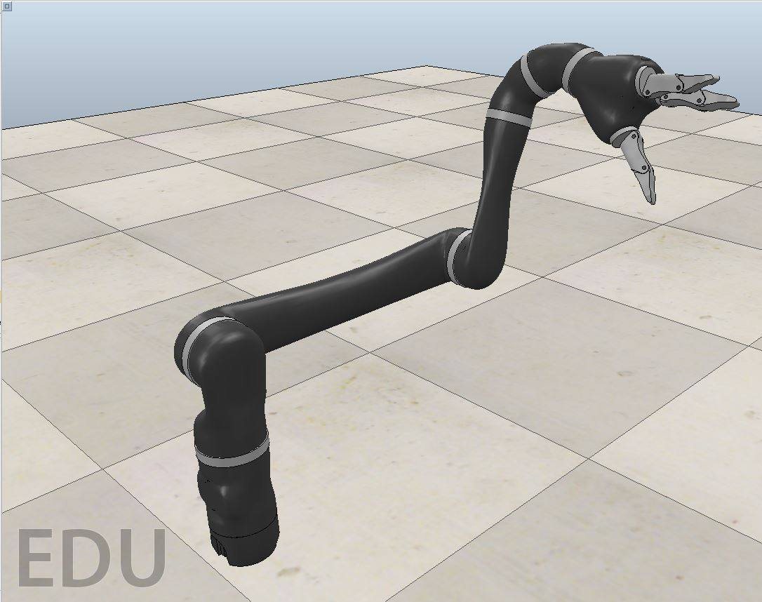

SSVEP based BCI towards continuously control robotics
• Steady state visually evoked potential (SSVEP) has been the generally high signal-to-noise ratio (SNR) and high information transfer rate (ITR).
• An electrical potential that is evoked from visual cortex within approximately 300 ms after the presentation of visual stimulus.
SLOW
FAST
Updating intensities of stimuli
Pay Attention
Visual Feedback
Stimulation Interfaces
Frequency
classification
Direction Control
Brain signal acquisition
Pre-processing
Feature extraction
Speed Levels
Human
Response
Predictive model for SSVEP amplitude modulations
Jaco arm

Slide 6
Let’s get your hands dirty!
Let’s go to our workshop…

